Slide 1
CAMEO® Software Suite Update
Brianne Connolly
CAMEO Program Manager
NOAA Office of Response and Restoration
April 18, 2023
Photo: NOAA

Slide 2
CAMEO® Suite
Helps first responders prepare for
and respond to chemical emergencies
Vital response recommendations
Background info on hazardous chemicals
Hazard predictions from mixing chemicals
Threat area estimates from toxic chemical cloud, fire, or explosion
Photo: U.S. Air Force
Notes:
The CAMEO® suite, created through a 35-year partnership with the EPA, is a software suite designed to help first responders prepare for and respond to chemical emergencies.
CAMEO Chemicals is a database program in CAMEO with thousands of hazardous chemical datasheets and a tool for predicting possible hazards from mixing chemicals.
Available as a desktop program, website, and mobile app.
The website receives an average of 3.5 million visits a year.
The mobile app is NOAA’s most downloaded app.
ALOHA® is a hazard modeling program in CAMEO that estimates how a toxic cloud might disperse downwind after a chemical release. It also includes some fire and explosion models for chemical spills.
MARPLOT® is a GIS mapping tool that amplifies CAMEO’s functionality, allowing users to add objects to maps, as well as view and edit data associated with those objects.
The suite also includes CAMEO Data Manager and Tier2 Submit, both of which help manage data about chemical facilities in local communities.

Slide 3
CAMEO® Software Suite
Developed jointly by NOAA and EPA for 35 years
CAMEO Chemicals
CAMEO Data Manager
Tier2 Submit™
ALOHA®
MARPLOT ®
250,000 downloads and 3.5 million page views (on CAMEO Chemicals site) annually
Notes:
CAMEO is the most widely used chemical emergency response and planning tool in the U.S. Used by firefighters, hazmat teams, emergency planners, and academics. Since it is used in emergencies, the programs need to function offline. Programs can be used interactively or solo.
Use the suite to:
Manage data for emergency planning and response (including facilities, chemical inventories, contact information, and response resources).
Access chemical property and response information.
Find out how chemicals could react if mixed.
Estimate threat zones for hazardous chemical releases, including toxic gas clouds, fires, and explosions.
Map threat zones and other locations of interest.
As part of a United Nations program, the CAMEO suite has been taught in over 50 countries and translated into many languages. (United Nations Environment Programme's Awareness and Preparedness for Emergencies at the Local Level [APELL] program.)

Slide 4
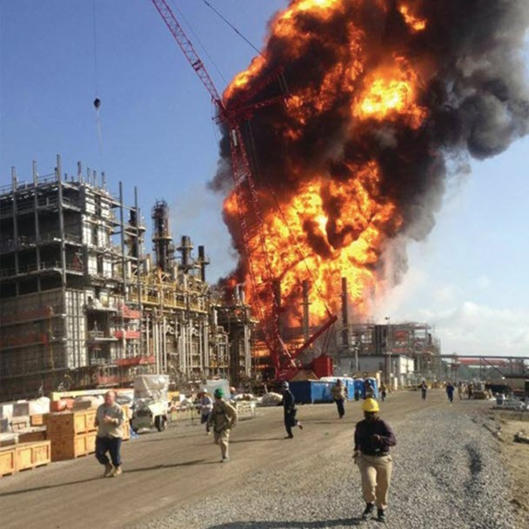
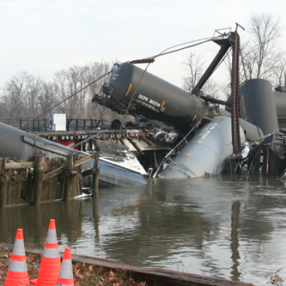
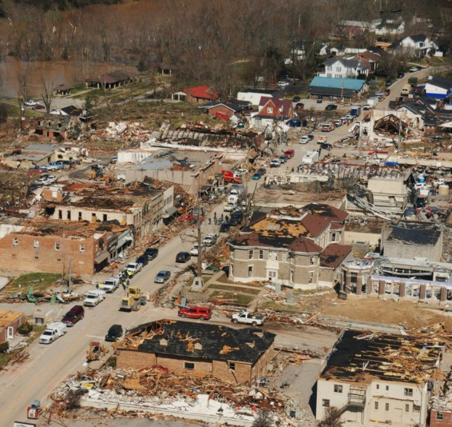
CAMEO Suite Uses
Fertilizer plant explosion, Louisiana, 2013
(Photo: U.S. Chemical Safety Board)
Train derailment, New Jersey, 2012
(Photo: NOAA)
Tornado damage, Kentucky, 2012
(Photo: NOAA)
To prepare for and respond to chemical emergencies
Notes:
The CAMEO suite can be used in many different types of emergency incidents, including explosions, train derailments, and even extreme weather events like tornados and hurricanes. For instance:
Use ALOHA to model explosions or look at potential toxic plumes from derailed train cars carrying hazardous chemicals.
Use CAMEO Chemicals to learn about chemical hazards and get response recommendations.
Use MARPLOT to map information about the path and damage zone for a tornado, and then cross reference that with data on storm shelters and property assessments to help aid search and rescue operations and complete damage reports for FEMA. (The cross-referencing step requires the user to import their own data.)
Firefighters and first responders are one of the primary audiences for the CAMEO suite, and they have some unique stakeholder requirements. For example, the ability for the suite programs to run offline is key for this group of users when internet may not be available during an emergency or in rural areas. Also, since two-thirds of the fire departments in the U.S. are comprised of all volunteer firefighters, their needs are an important consideration in development decisions.

Slide 5
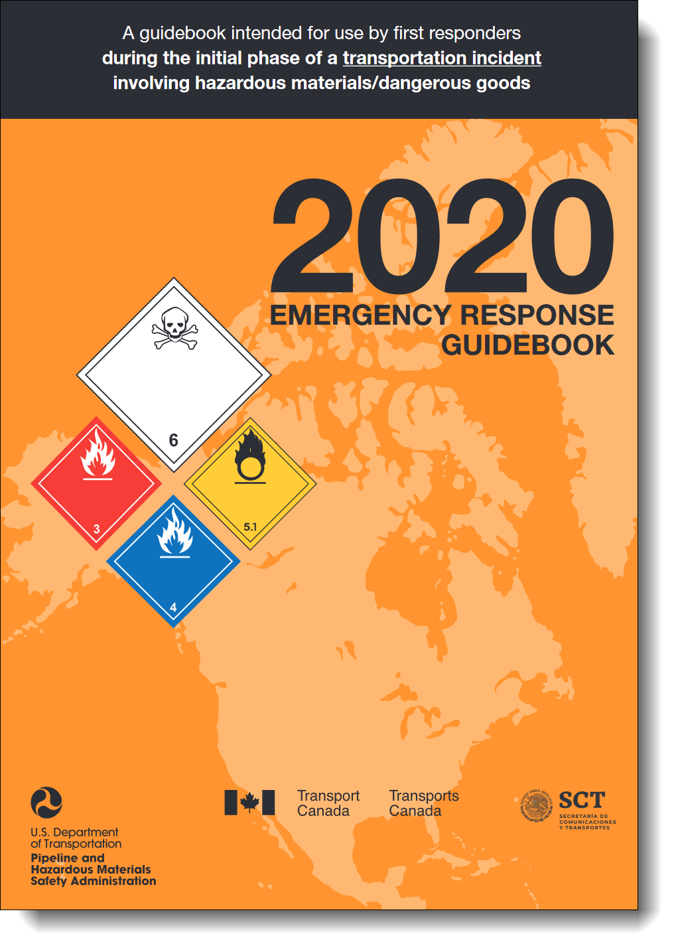
CAMEO’s Last Year in Review
April 2022: CAMEO Chemicals 2.8.0
November 2022: CAMEO Data Manager 4.2.0 and Tier2 Submit 2022
January 2023: Tier2 Submit 2022 “rev 1”
Winter 2022/2023: MARPLOT third-party tool patches
Ongoing: Prep work for the 2023 releases
Notes:
CAMEO Chemicals 2.8.0: Major data updates, including the 2020 ERG and updated regulatory information. Enhanced desktop platform frame, which was part of updates to allow the Mac version to run on the newest operating systems. Many behind-the-scenes structural updates and improvements.
CAMEO Data Manager 4.2.0 and Tier2 Submit 2022: Annual update with latest regulatory and state field changes. Also included updates to NAICS, FEMA Resource Types, and Census County Boundaries. Added official signature to Windows version and approved the programs for the latest Windows and Mac operating systems. Also, enhanced the Responder Summary in CAMEO Data Manager with hazards from the related chemical records.
Tier2 Submit 2022 “rev 1”: Primarily a bug fix to allow attachments to be deleted, but also adjusted a Maine state field and updated the EHS checks to the latest EPA List of List (released in December 2022).
MARPLOT Patches: Several small patches to fix issues with the third-party tools for Address lookup, Get Elevation, and Google basemaps.

Slide 6
What’s Coming Next?
Early Summer 2023: Opportunity for states, tribes, and territories to request any “state” field changes for the fall releases
Summer 2023: ALOHA 6.0.0 and CAMEO Chemicals 3.0.0
November 2023: Tier2 Submit 2023 and CAMEO Data Manager 4.3.0
Winter 2023/2024: MARPLOT (version TBD)

Slide 7
ALOHA 6.0.0 Sneak Peek & Feedback Opportunity

Slide 8
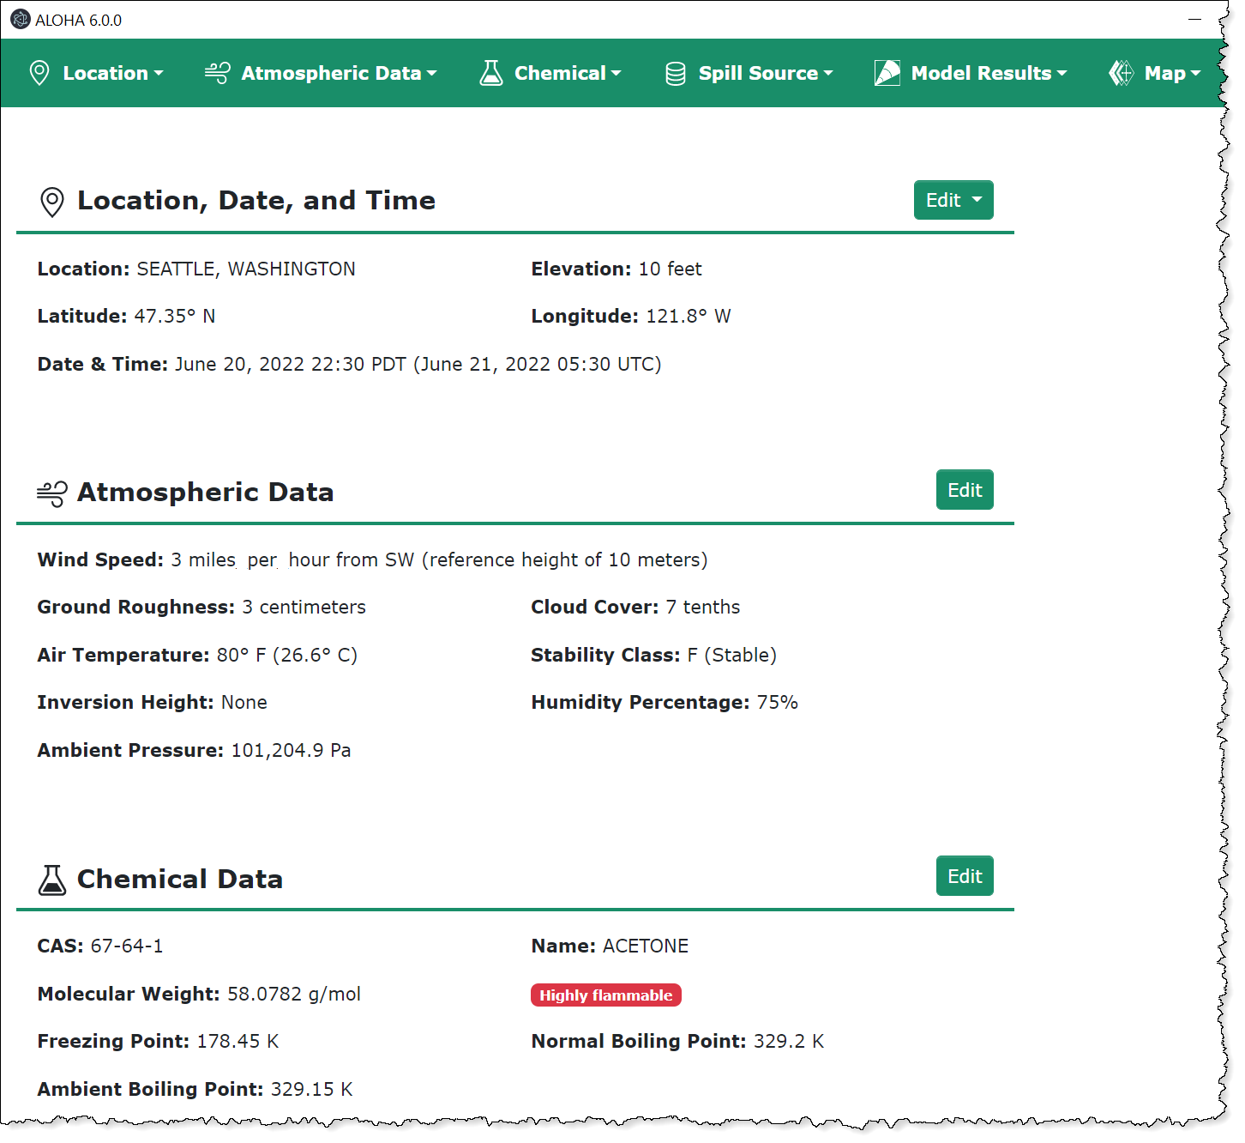
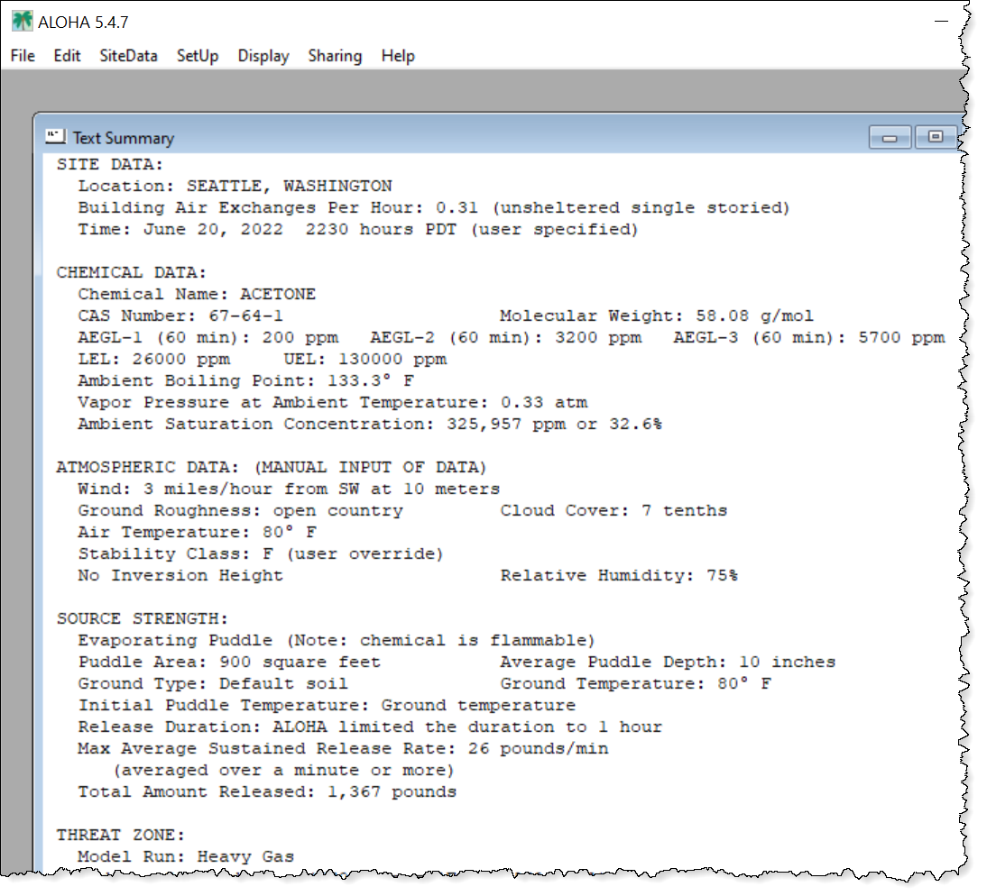

Slide 9
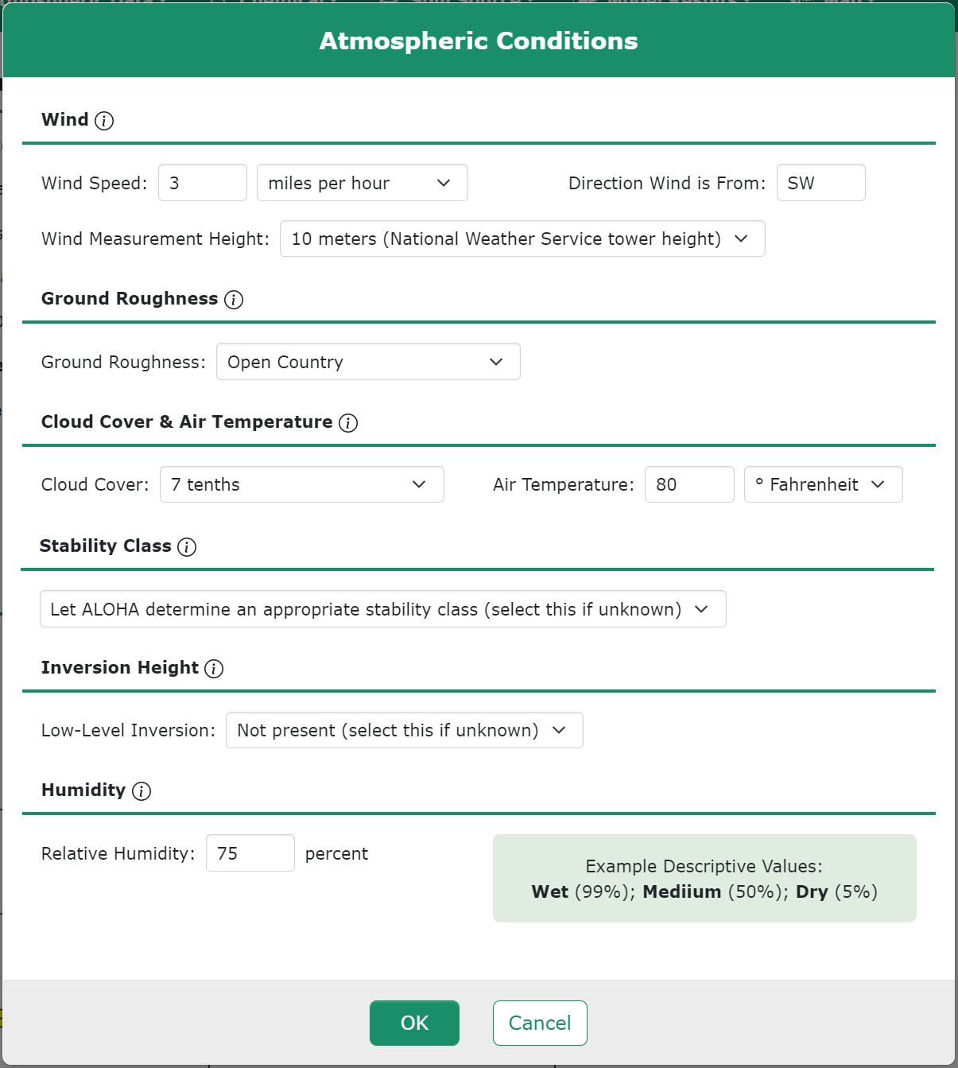
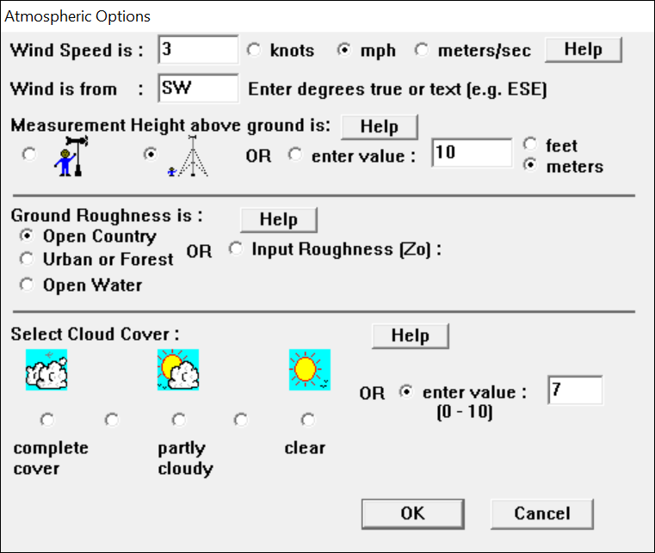
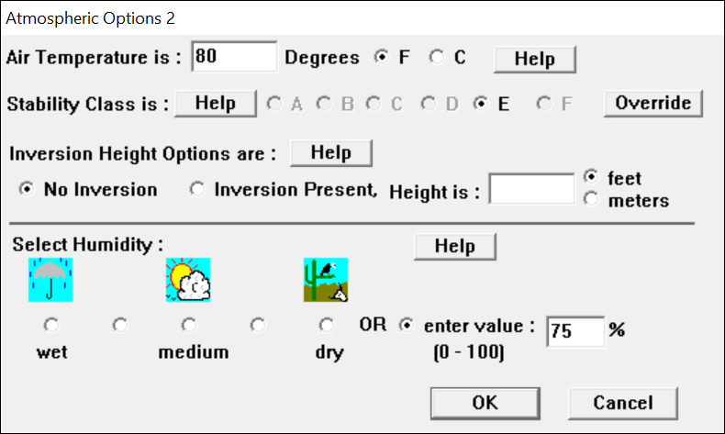

Slide 10
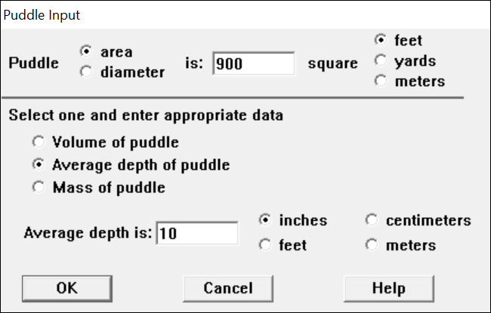
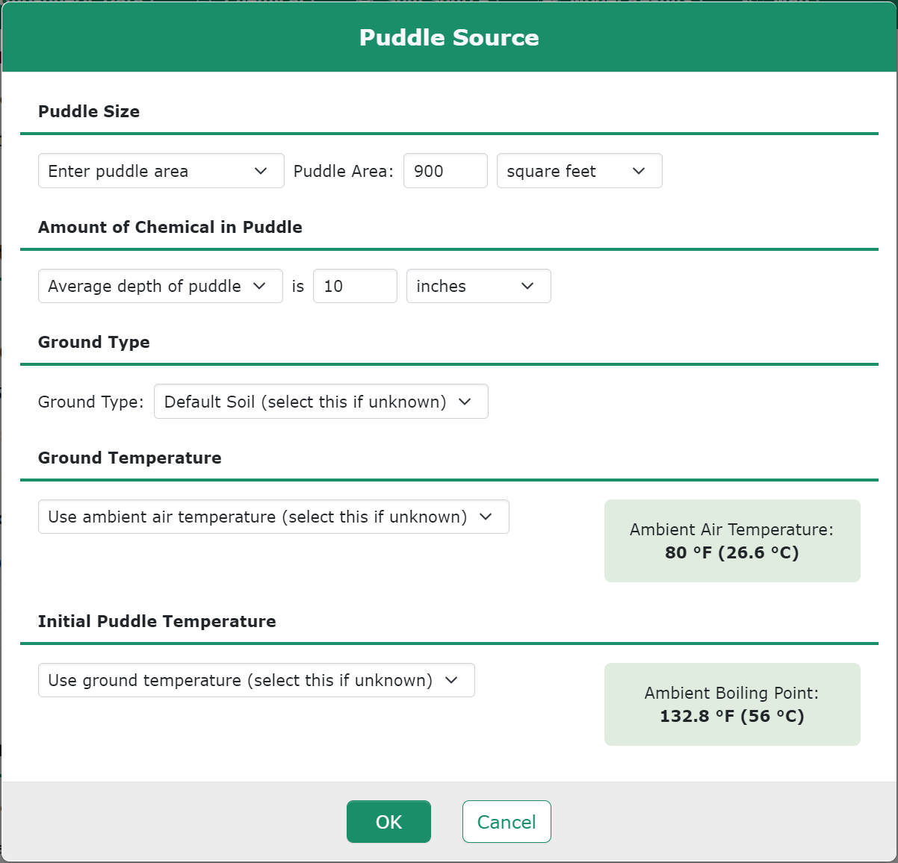
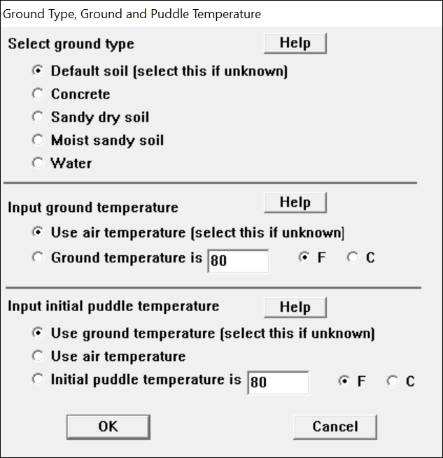

Slide 11
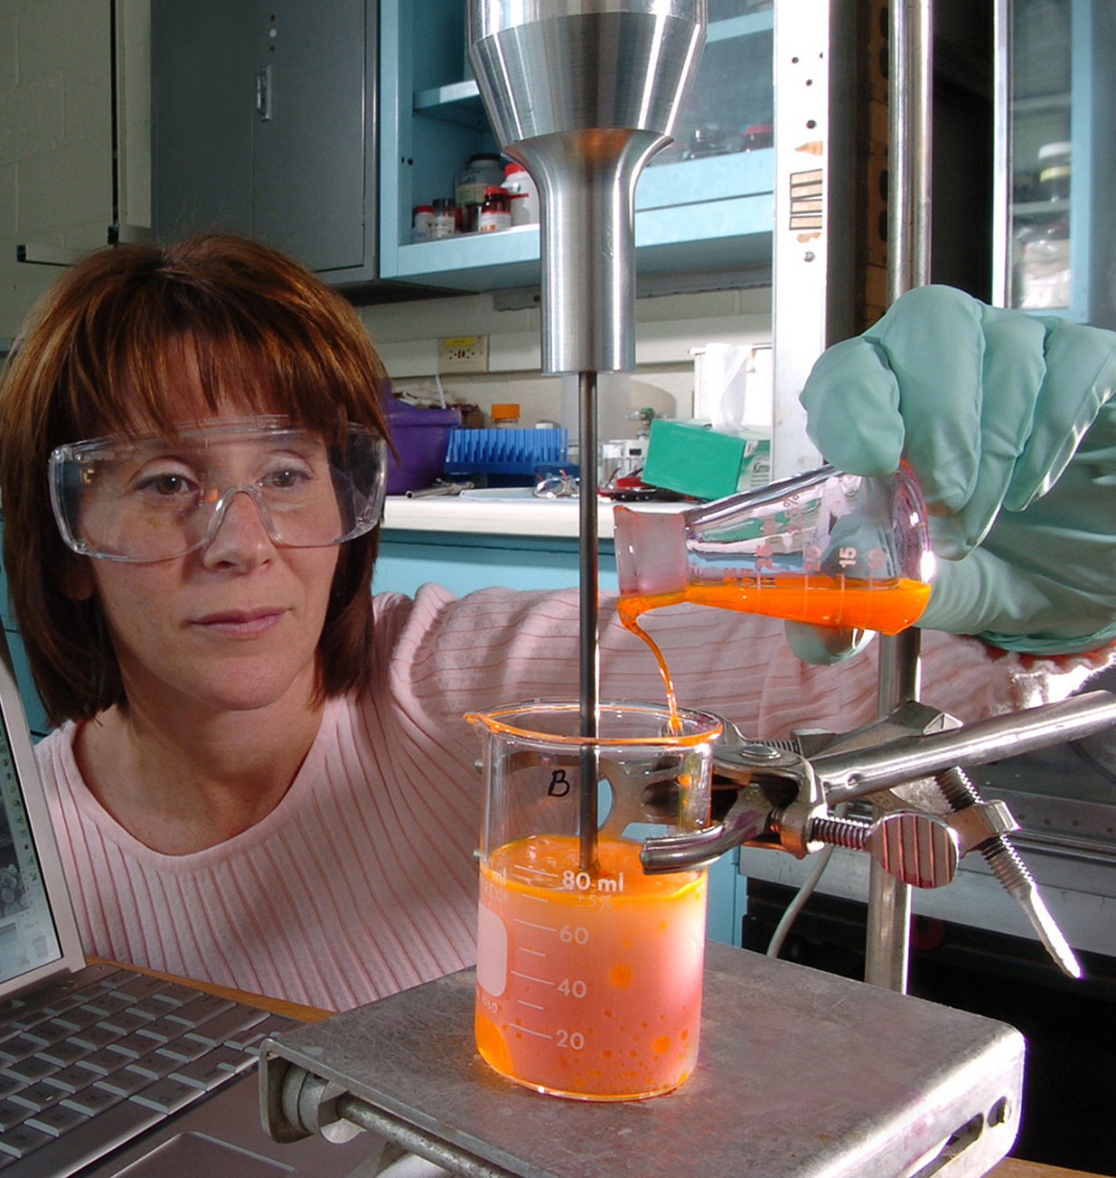
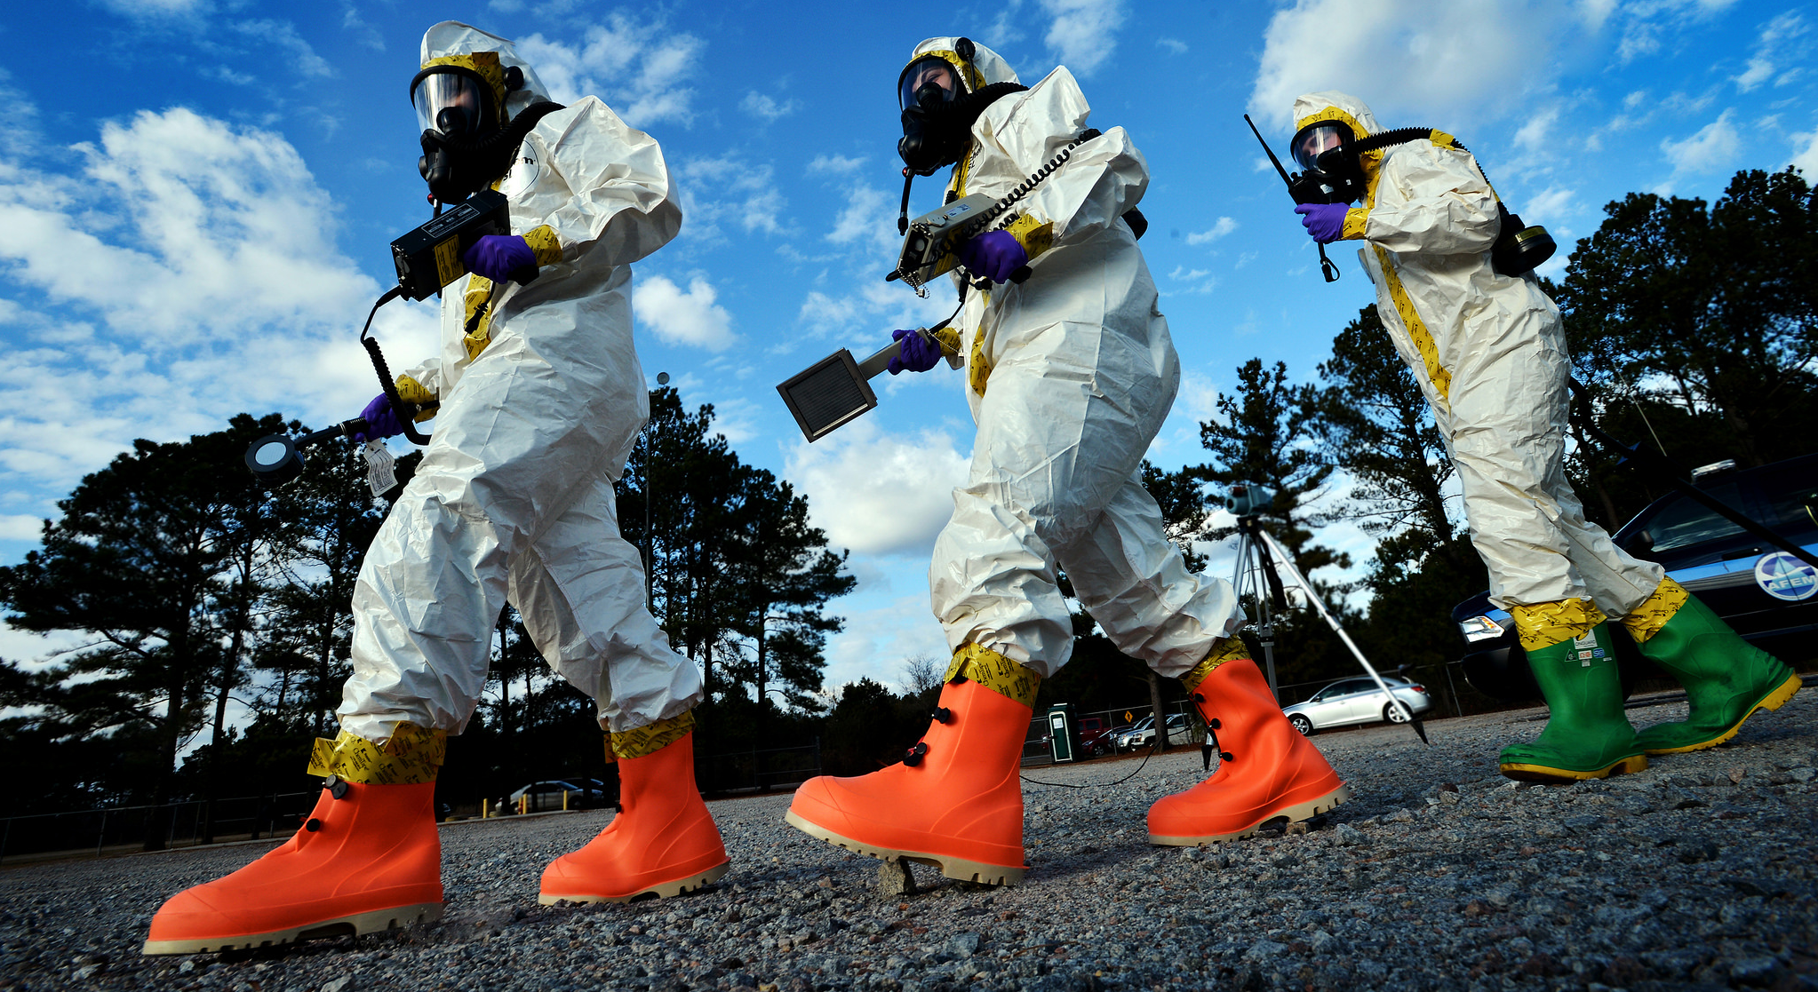
Photo: U.S. Dept of Energy
Photo: U.S Air National Guard
Photo: U.S. Air Force
Photo: U.S. Coast Guard
Photo: U.S. Air Force
Notes:
Questions?
User questions can be directed to orr.cameo@noaa.gov.
Users can sign up at https://public.govdelivery.com/accounts/USNOAANOS/subscriber/new?topic_id=USNOAANOS_187 to get the latest CAMEO News.

